Slide 1

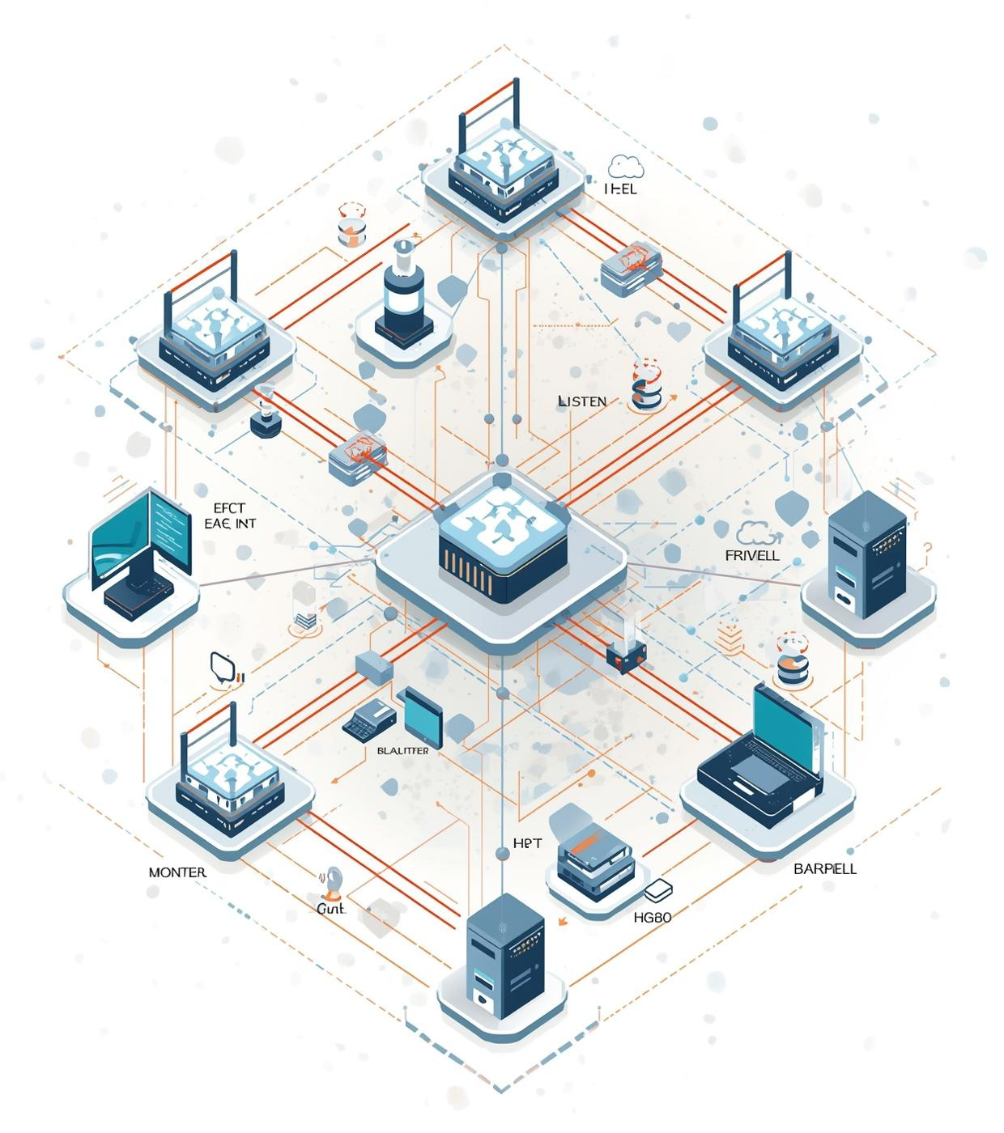
National Bank Network Infrastructure Project
Cisco & FortiGate Integration Simulated in GNS3
Team Members and Supervisors Listed Below

Slide 2

Project Team
Contributors and Supervisors Behind the National Bank Network Project
Ziad Refaie AbuAlftooh
Abdullah Ibrahim Abdo
Mahmoud Mohamed Mahmoud Fahim
Haitham Ibrahim Mahmoud Hosny
Abdullah Muhammad Khalifa
Ahmed Mohamed Ahmed
Abdullah Abdelrehim Hassan
Supervisors: Eng. Elhosien Ahmed & Dr. Hussien Harb

Slide 3
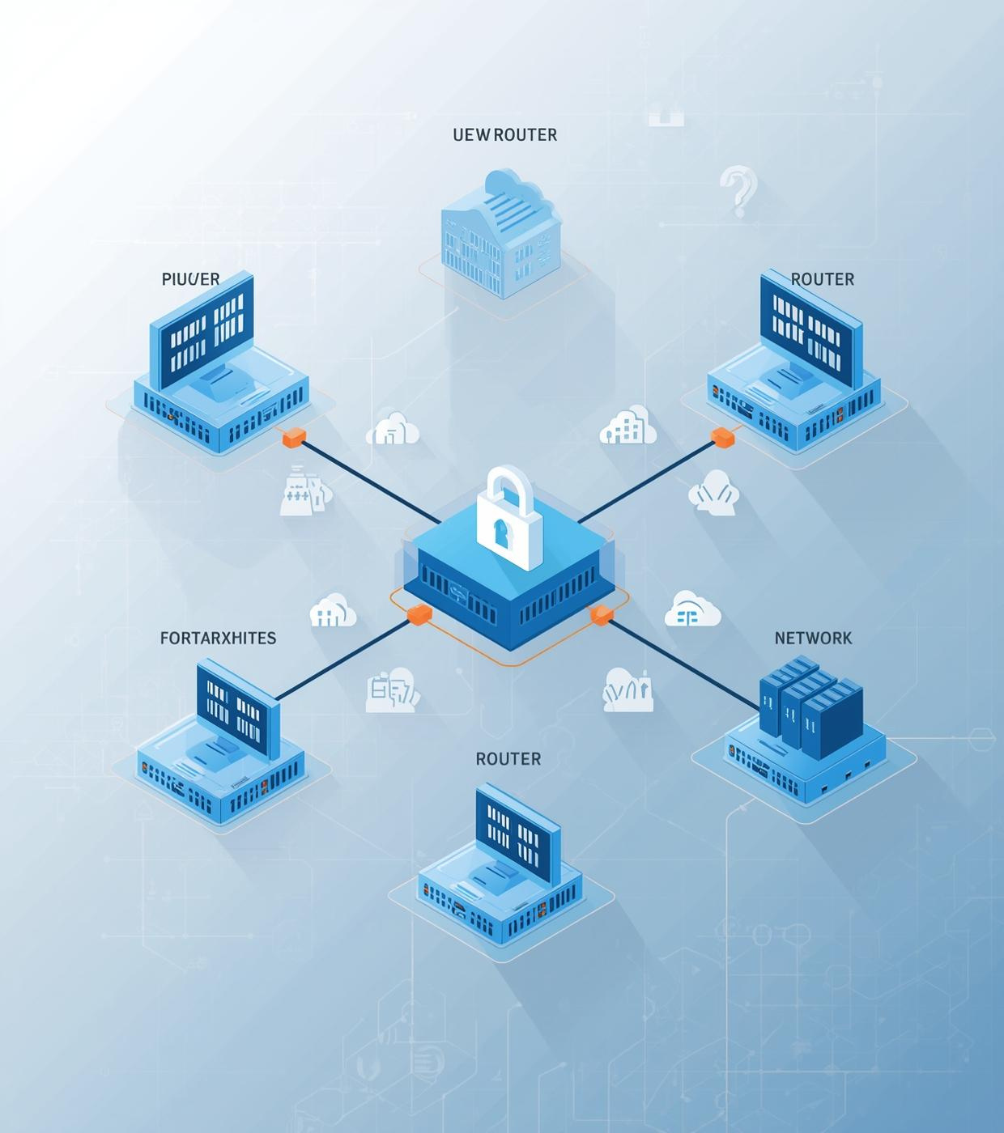
Project Overview
Summary of the National Bank’s network design and implementation process
Secure HQ with 4 branches
Integrated Cisco routers and switches
Utilized FortiGate for robust security
Simulated network in GNS3

Slide 4
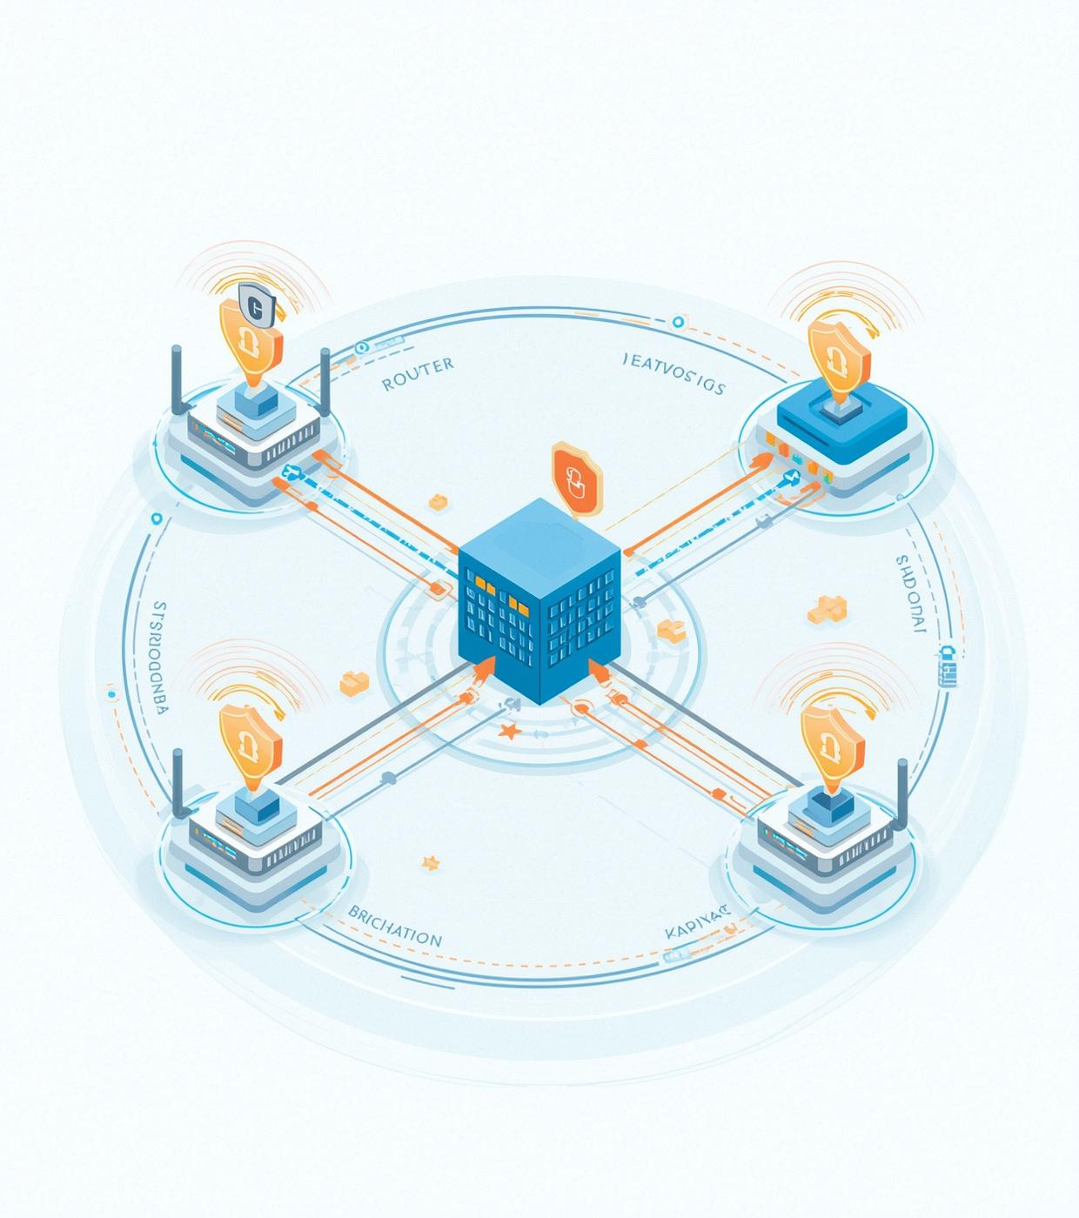
Network Topology
Secure Headquarters with Four Branches Connected via WAN Links
HQ and branch connectivity
Cisco routers and FortiGates
OSPF routing and VLANs
WAN link integration

Slide 5
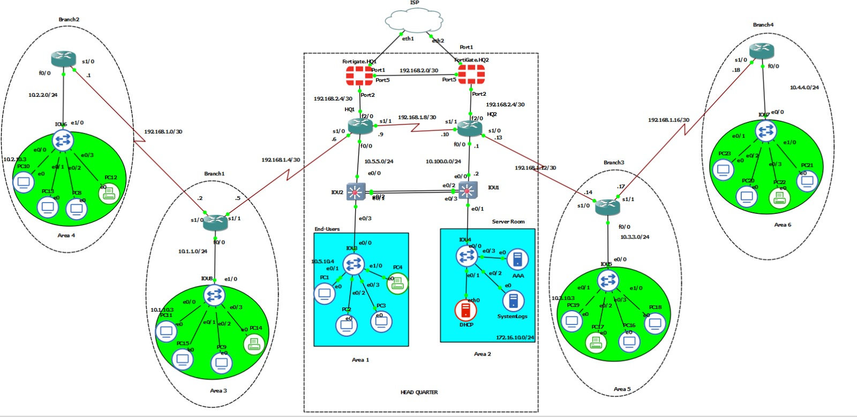

Slide 6
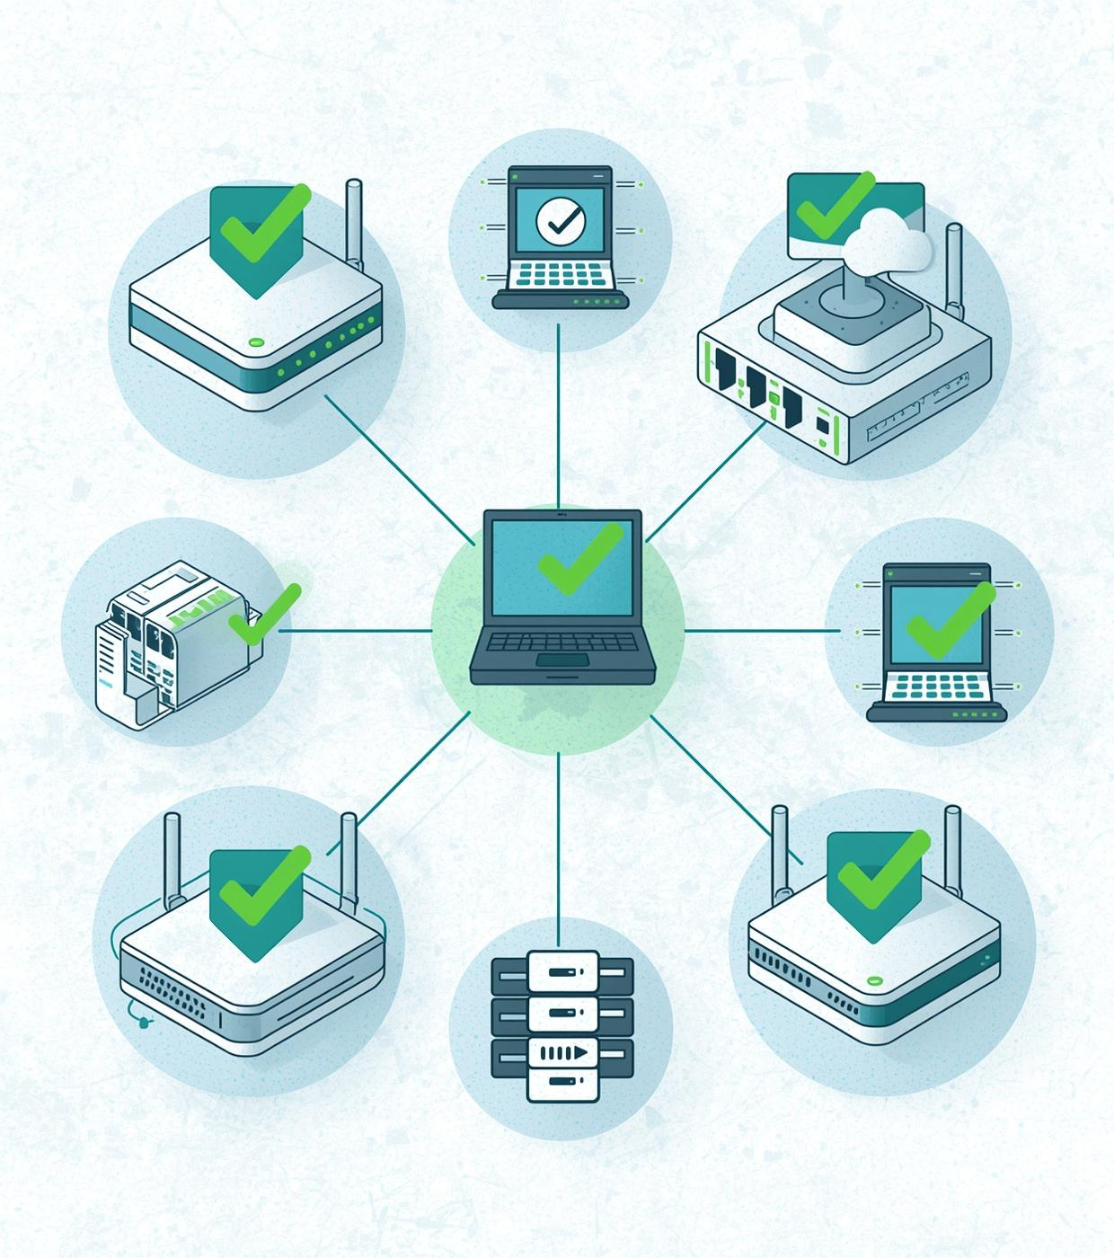
Completed Tasks
Overview of the significant milestones achieved in the project
Topology built with HQ and branches
OSPF configured on all routers
Static IPs assigned and VLANs established
End-host connectivity ensured and DHCP servers configured
HA cluster created for FortiGates
Security policies implemented and policy routing integrated

Slide 7
Security Challenges
Data Confidentiality Implementation
Threat Mitigation Strategies Developed
HQ-Branch Security Enhancements
Enforced strict data protection protocols
Integrated advanced security measures across all branches
Improved connectivity with enhanced security features

Slide 8
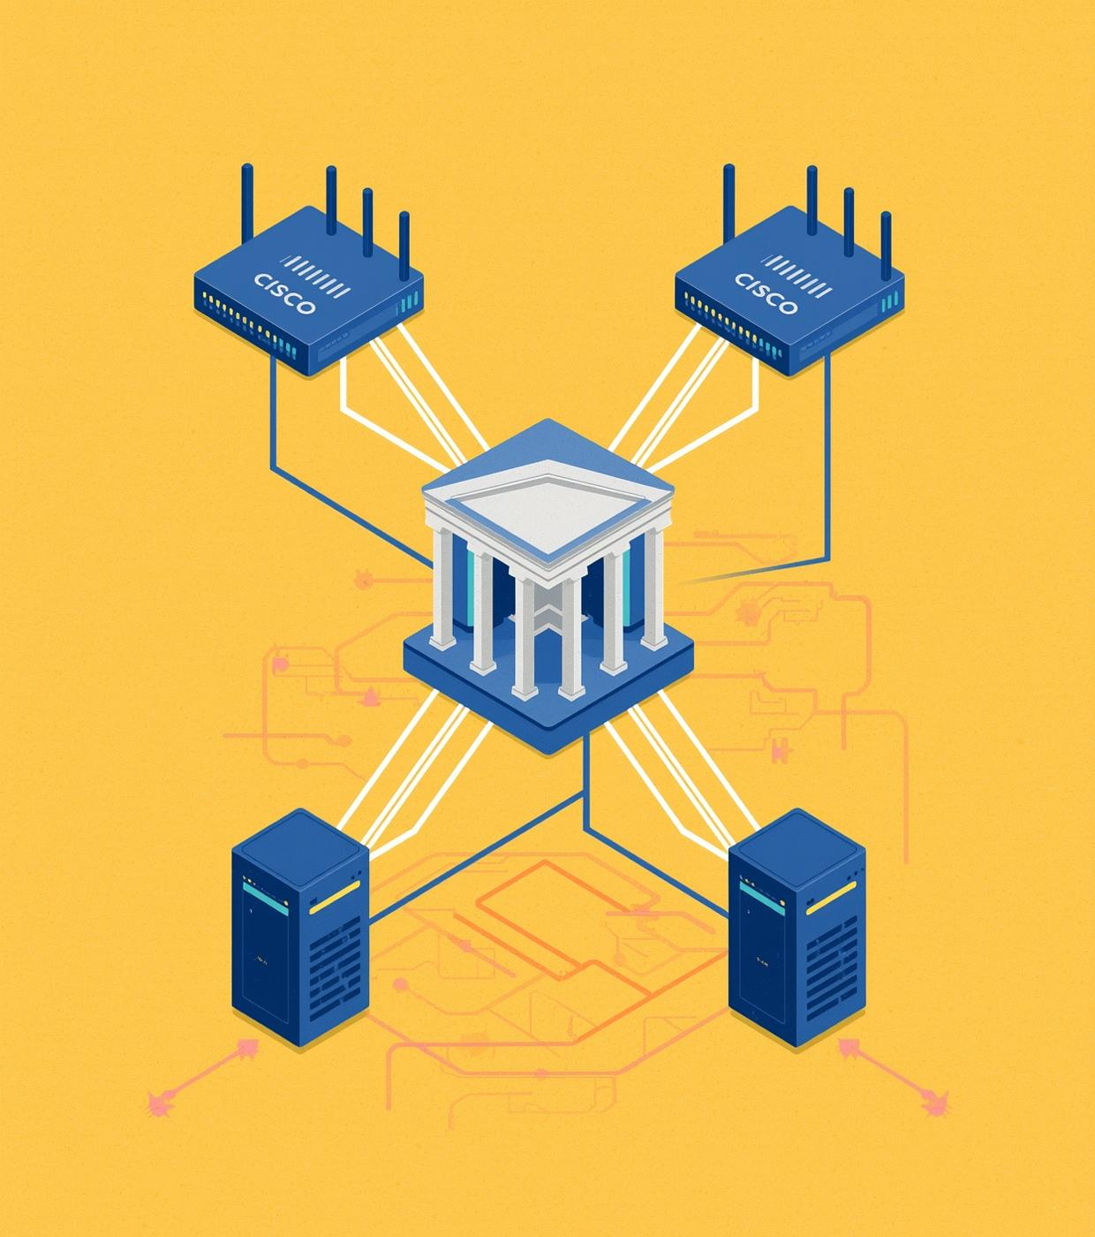
Project Scope
Detailed Components of HQ and Branch Network Design
HQ: 2 Routers, 2 Layer 3 Switches
2 Layer 2 Switches, 2 FortiGates in HA
Branches: 1 Router, 1 Switch, 1 FortiGate each

Slide 9
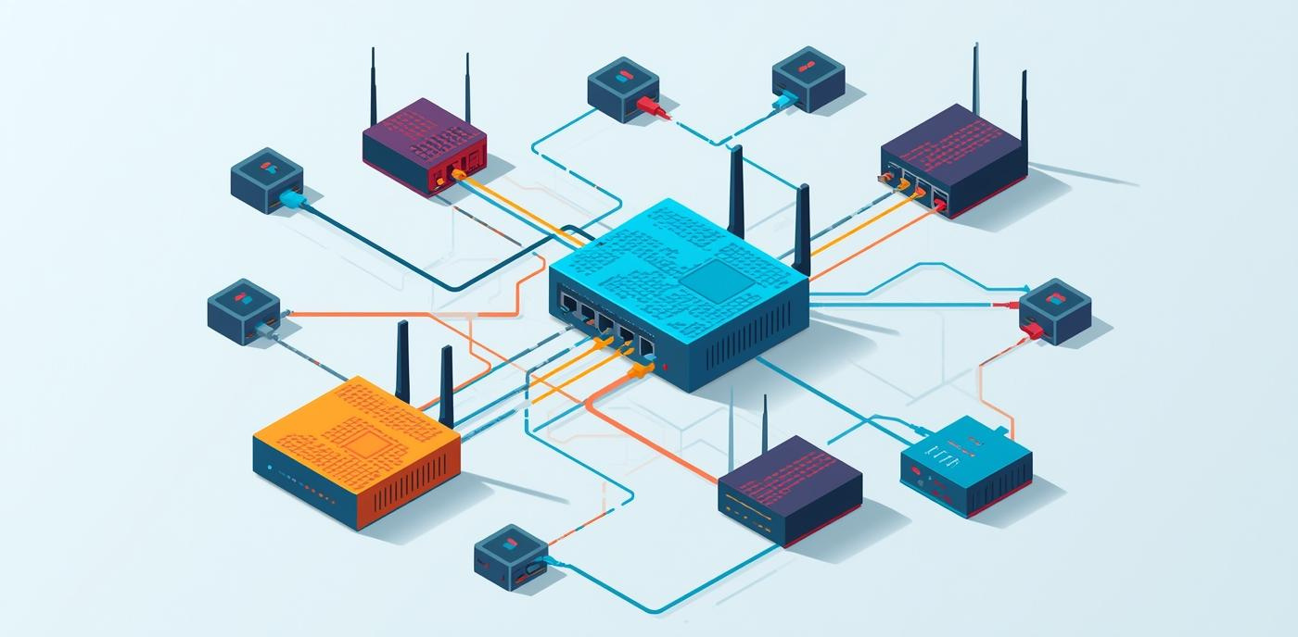

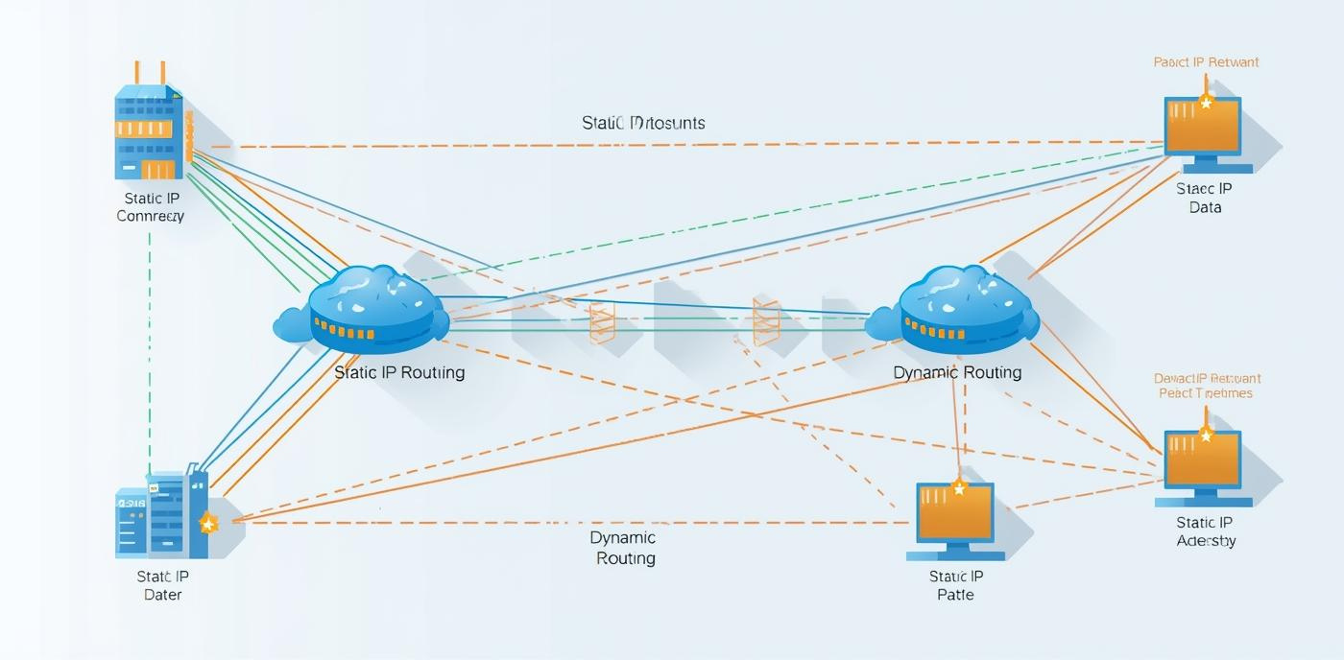
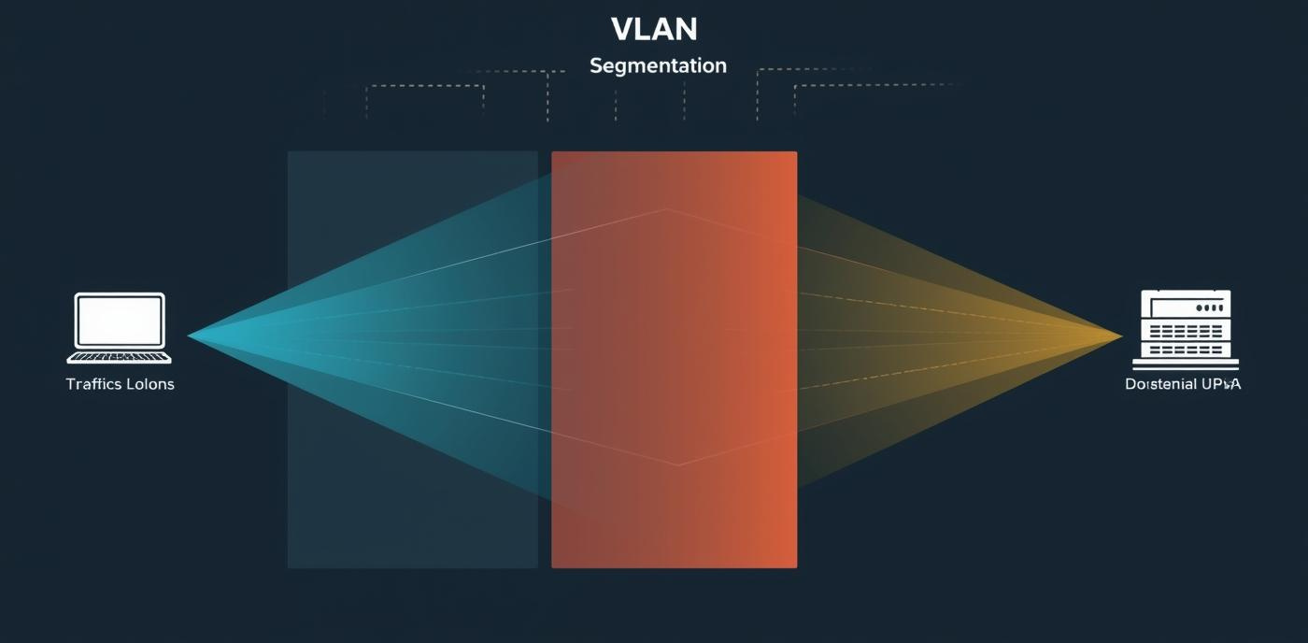
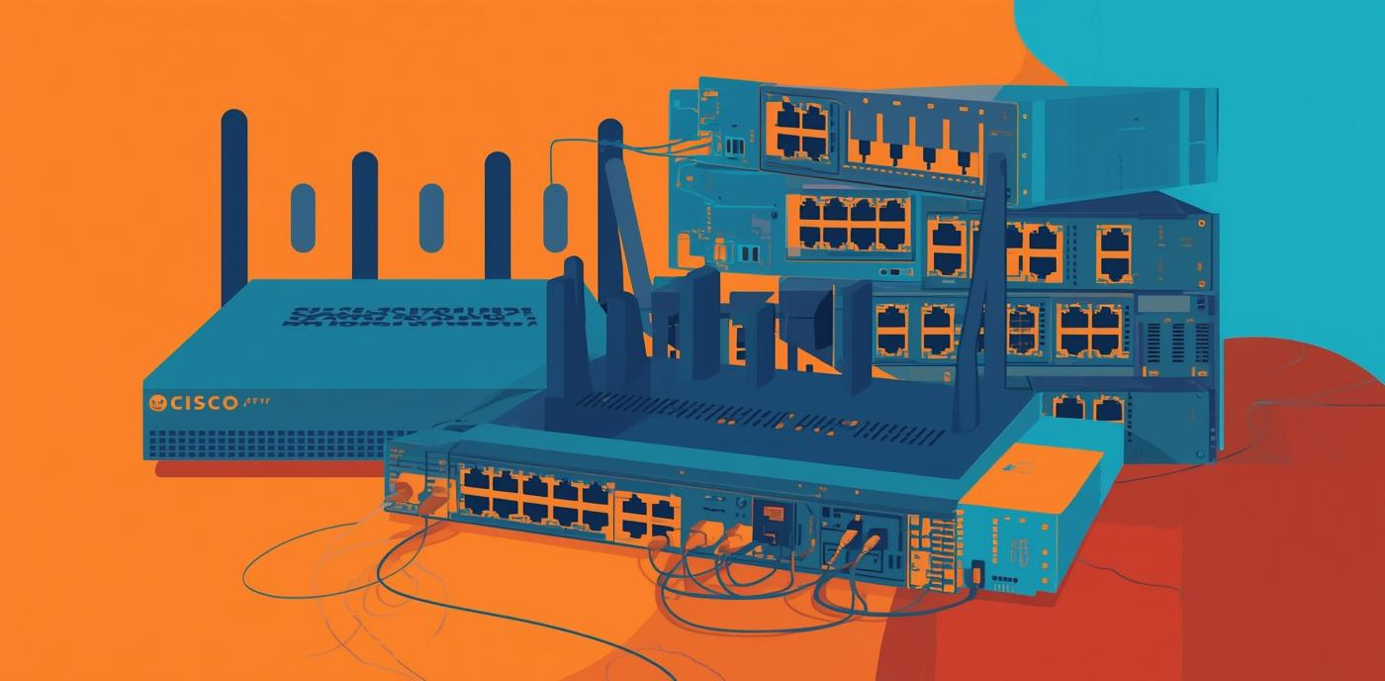
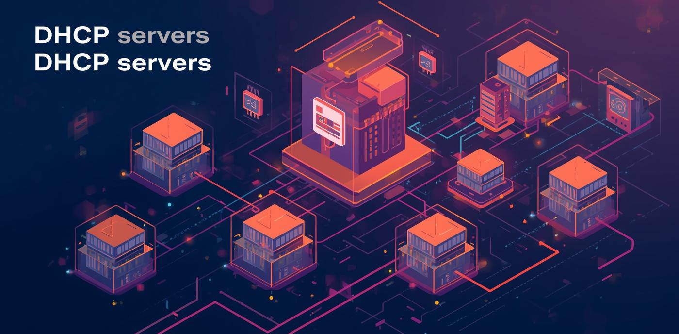
Static IP
Dynamic Routing
VLAN Segmentation
Ensures stable connectivity for all locations
Utilizes OSPF for efficient path selection
Improves security through traffic isolation
Hardware
DHCP Servers
VLAN Management
Cisco routers and switches for reliability
Automatic IP allocation for efficiency
Segments network for better performance

Slide 10
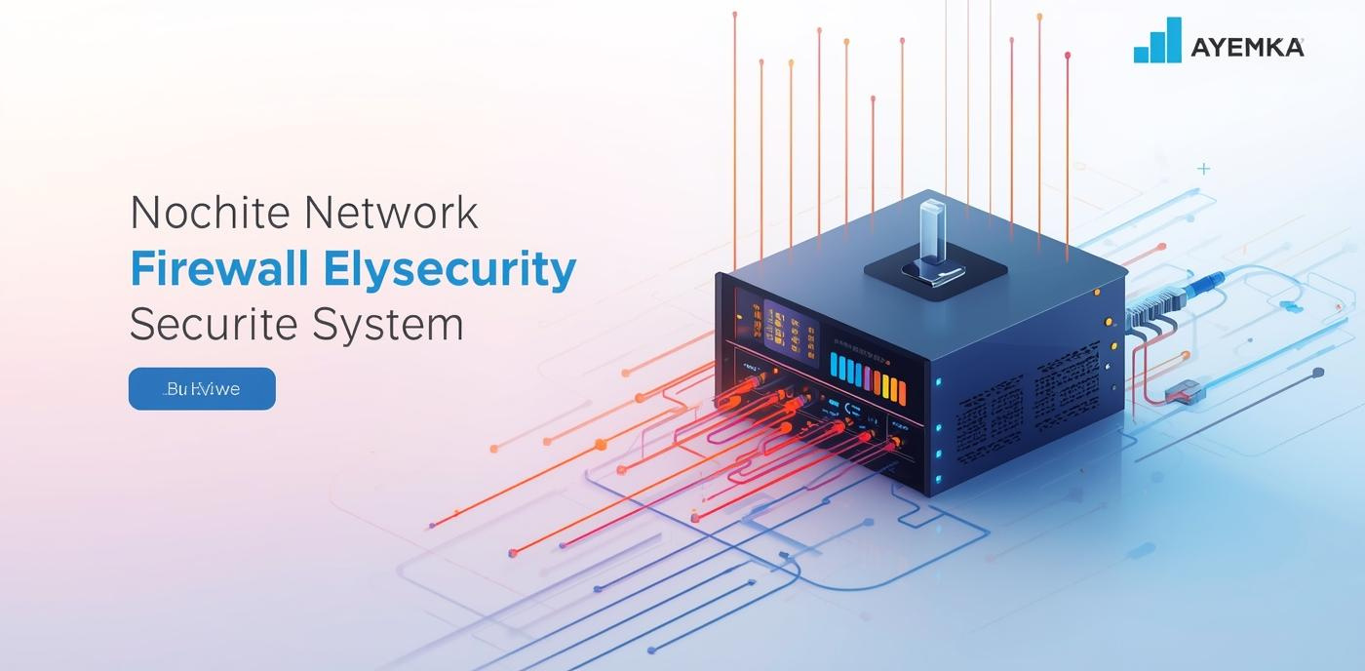
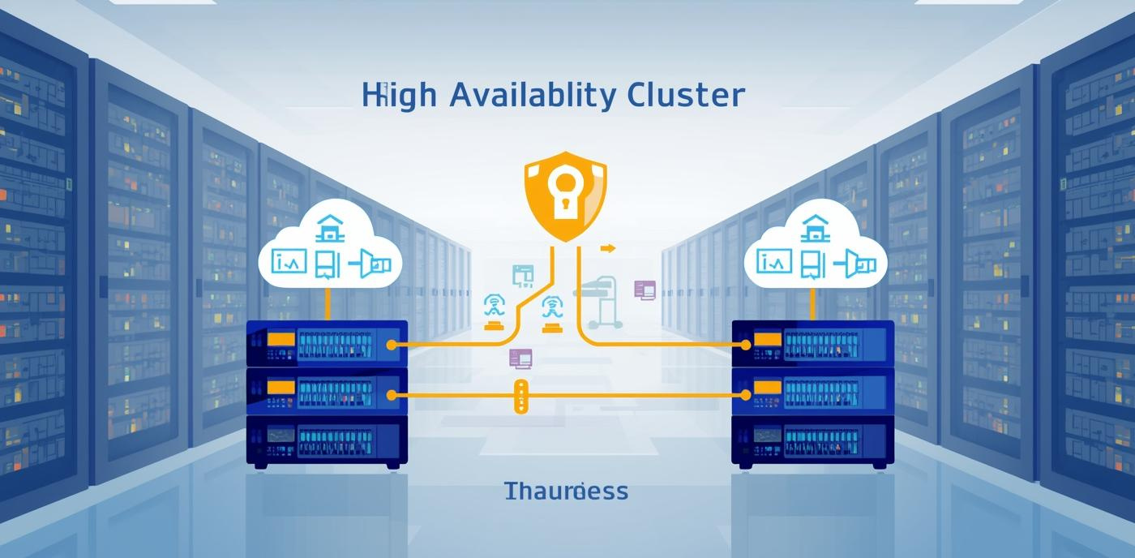




High Availability
Local Security
Traffic Management
Dual FortiGate firewalls for redundancy
Branch firewalls enforce local policies
Policy-based routing for efficiency
Security Policies
Threat Protection
Optimized Routing
Managing traffic flow effectively
Safeguarding sensitive data
Enhancing network efficiency

Slide 11
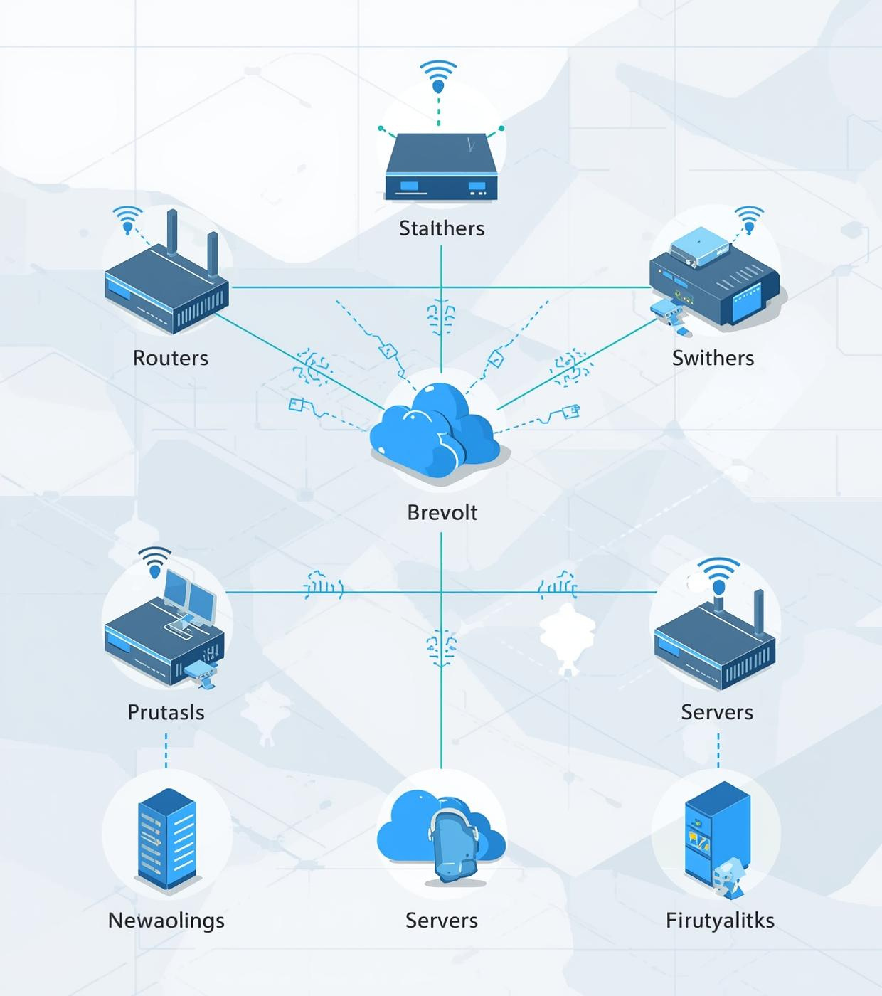
GNS3 Simulation Setup
Detailed overview of the device list and key features configured
2 HQ FortiGates in HA
6 Cisco routers and 8 switches
~20 end devices included

